Slide 1
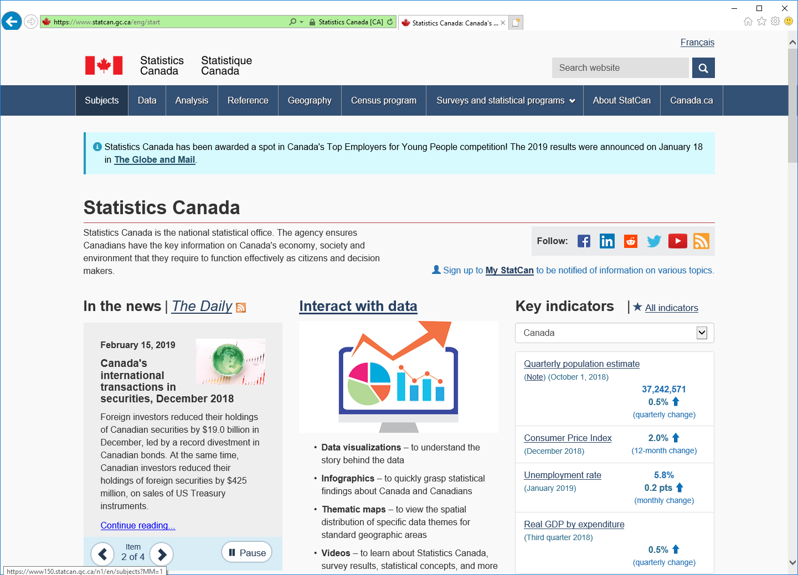
Procedure to obtain Labor Cost Index data for Canada
Go to :
Click on “Subjects”
https://www.statcan.gc.ca/eng/start

Slide 2
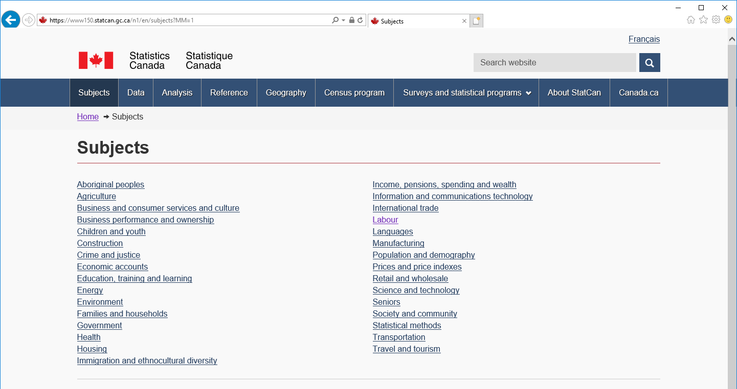
Procedure to obtain Labor Cost Index data for Canada
Click on “Labour”
`

Slide 3
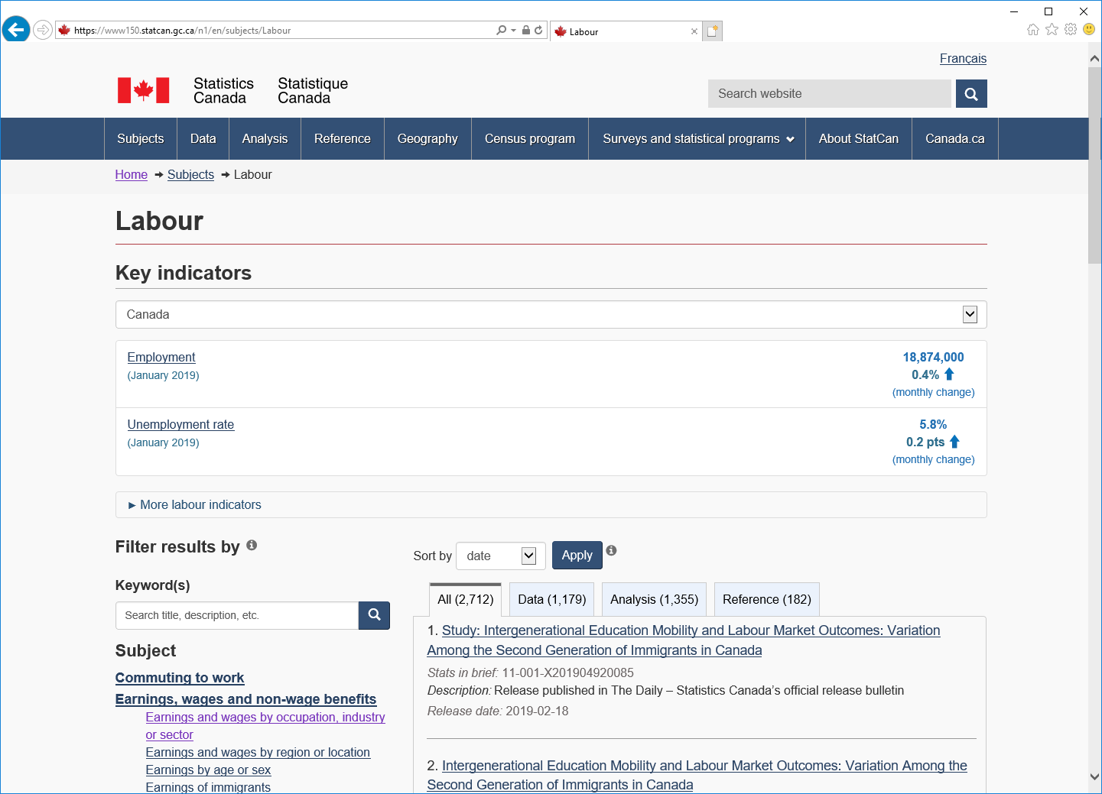
Procedure to obtain Labor Cost Index data for Canada
Click on “Earnings and wages by occupation, industry or sector”
`

Slide 4
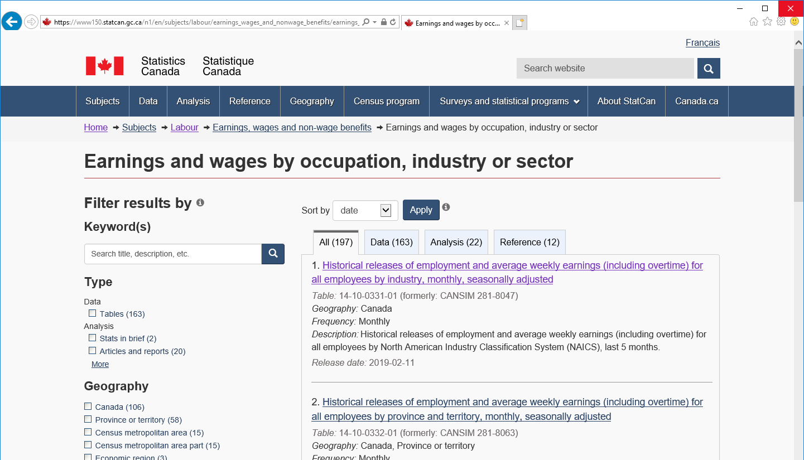
Procedure to obtain Labor Cost Index data for Canada
Click on “Historical releases of employment and average weekly earnings (including overtime) for all employees by industry, monthly, seasonally adjusted”
Note: this could show further down the list as these items are presented by most recent release date, use the search bar
`

Slide 5
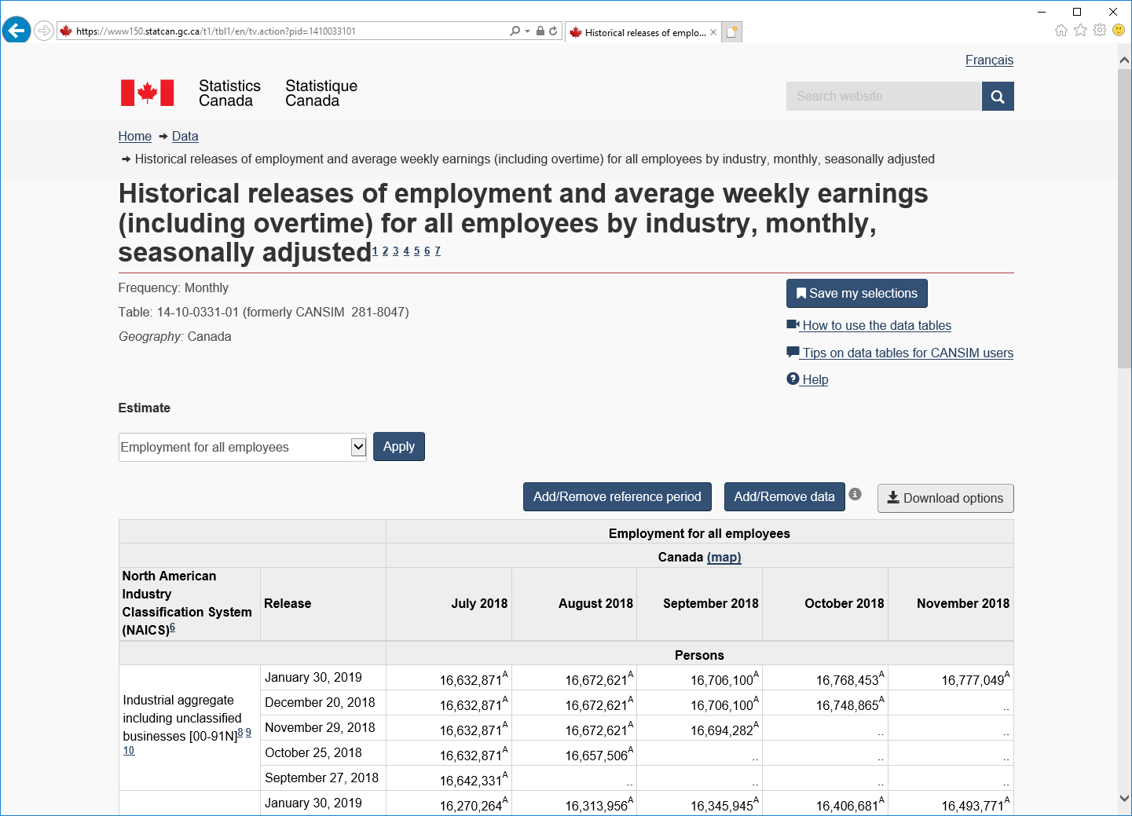
Procedure to obtain Labor Cost Index data for Canada
Click on any of the “Add/Remove” options to access the data query customization screen
`

Slide 6
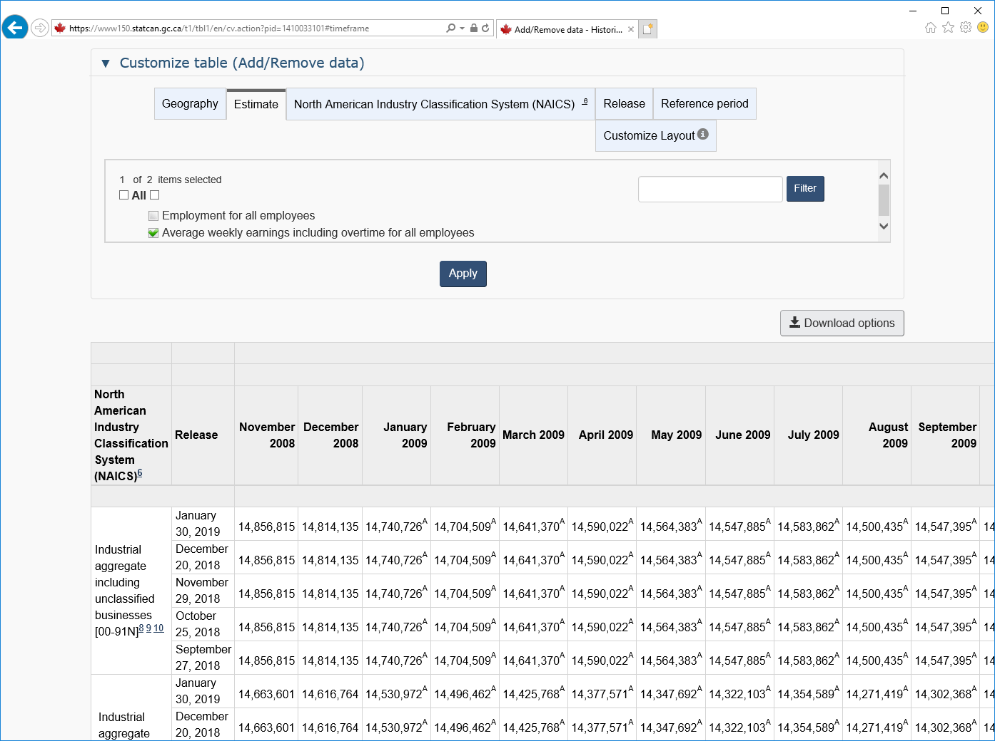
Procedure to obtain Labor Cost Index data for Canada
Click on “Estimate” tab
Select “Average weekly earnings including overtime for all employees”
Click on “Apply”
`

Slide 7
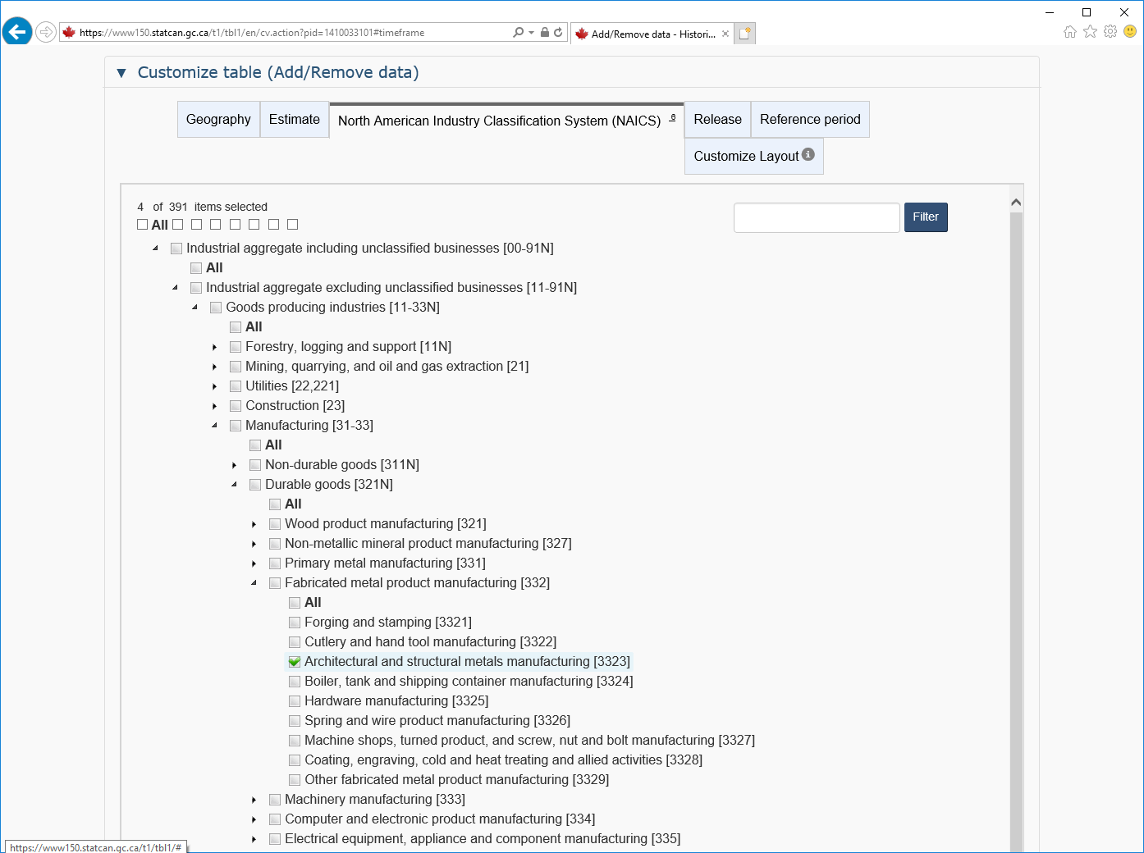
Procedure to obtain Labor Cost Index data for Canada
Click on “NAICS” tab
Select the industry of interest. For example “Architectural and structural metals manufacturing [3323]”.
Note: the digits refer to the first few digits of the NAICS code of the industry
Click on “Apply” (below)
`

Slide 8
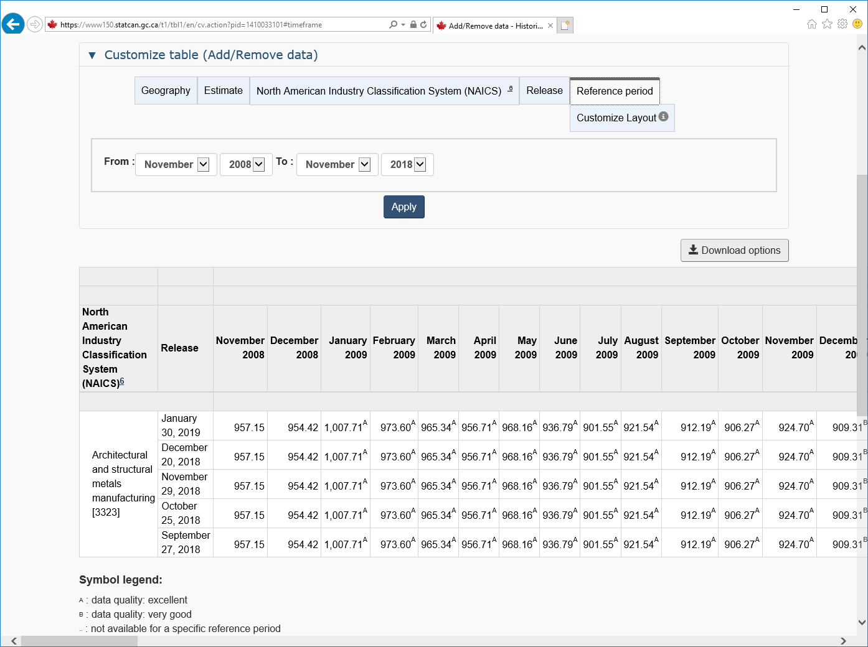
Procedure to obtain Labor Cost Index data for Canada
Click on “Reference period” tab and select the time period of interest
Click on “Apply”
The monthly average weekly earnings values are displayed in a table
Data can be downloaded in Excel (csv) format by clicking “Download options”
`
`

